Slide 1

To house or not to house

Slide 2
Quality, SQFT, and Year Built are the top 3 price determining factors

Slide 3
Quality is the #1 Price driving factor.
YrSold | SaleType | SaleCondition | SalePrice | OverallQual | OverallCond | Id
2007 | WD | Normal | $ 755,000.00 | 10 | 6 | 692
2007 | WD | Abnorml | $ 745,000.00 | 10 | 5 | 1183
2006 | WD | Normal | $ 625,000.00 | 10 | 5 | 1170
2010 | New | Partial | $ 611,657.00 | 9 | 5 | 899
2009 | New | Partial | $ 582,933.00 | 9 | 5 | 804
2006 | New | Partial | $ 556,581.00 | 9 | 5 | 1047
2009 | WD | Normal | $ 555,000.00 | 10 | 5 | 441
2010 | WD | Normal | $ 538,000.00 | 8 | 5 | 770
2009 | New | Partial | $ 501,837.00 | 9 | 5 | 179
2009 | New | Partial | $ 485,000.00 | 9 | 5 | 799

Slide 4
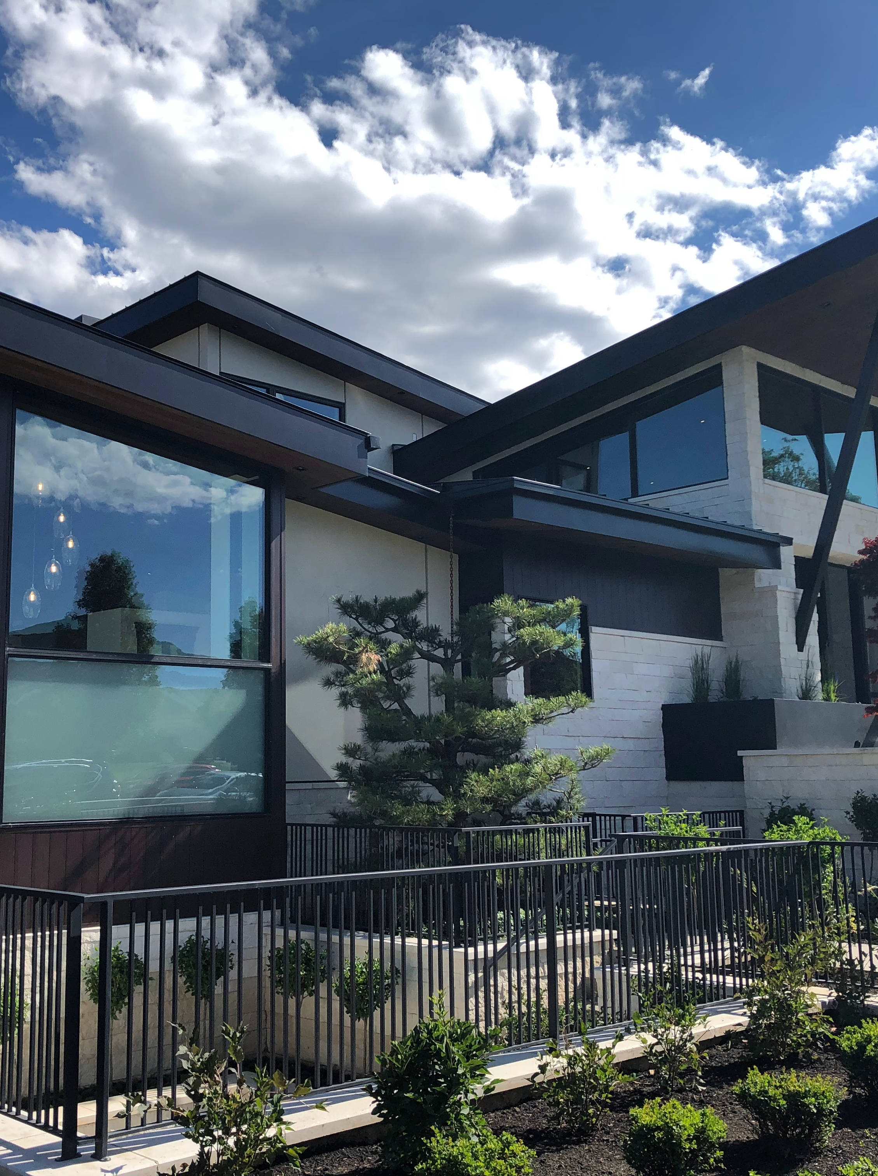
Everyone loves a large house so market on SQFT.

Slide 5
Quickness of sale by SQFT
SalePrice 1stFlrSF 2ndFlrSF YearBuilt YrSold
$ 394,432.00 4692 0 2010 2010
$ 611,657.00 3228 0 2009 2010
$ 402,861.00 3138 0 2009 2009
$ 395,192.00 2898 0 2009 2010
$ 370,878.00 2633 0 2009 2009
$ 233,170.00 2524 0 2009 2009
$ 222,000.00 2515 0 2009 2010
$ 224,000.00 2444 0 2009 2010
$ 229,456.00 2411 0 2009 2009
$ 198,900.00 2402 0 2009 2010
$ 208,300.00 2392 0 2009 2009

Slide 6

Avoid older homes the average condition they are in is 5 out of 10 or less

Slide 7
Ancient homes sale for less.
YrSold | SaleType | SaleCondition | SalePrice | OverallCond | YearBuilt
2009 | WD | Normal | $ 61,000.00 | 1 | 1922
2010 | New | Partial | $ 394,432.00 | 2 | 2010
2006 | WD | Normal | $ 87,000.00 | 2 | 1900
2009 | ConLD | Abnorml | $ 85,000.00 | 2 | 1915
2010 | WD | Normal | $ 76,500.00 | 2 | 1940
2007 | WD | Abnorml | $ 67,000.00 | 2 | 1920
2007 | WD | Alloca | $ 200,624.00 | 3 | 1957
2009 | WD | Normal | $ 197,000.00 | 3 | 1920
2007 | WD | Normal | $ 163,500.00 | 3 | 1970
2009 | WD | Normal | $ 156,500.00 | 3 | 1957
2007 | Oth | Abnorml | $ 150,000.00 | 3 | 1977
2006 | WD | Normal | $ 137,900.00 | 3 | 1951
2009 | WD | Normal | $ 135,000.00 | 3 | 1928
2009 | COD | Abnorml | $ 112,000.00 | 3 | 1956

Slide 8
Thank you For Your time!!!!

